Slide 1
Project 3 Checklist

Slide 2
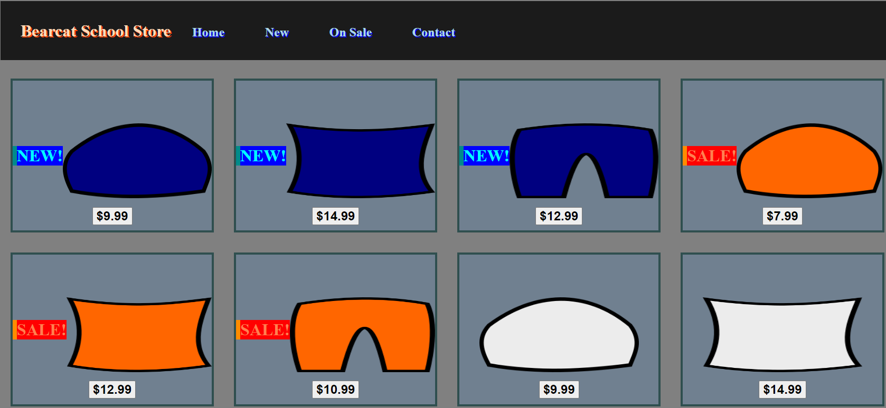
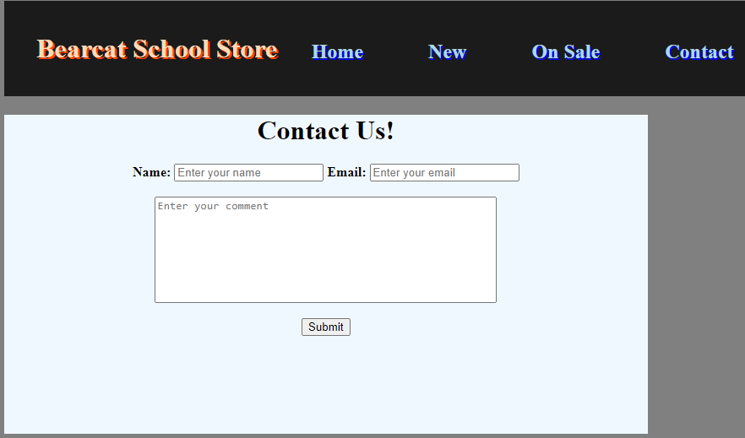
Project Overview

Slide 3
Day 1: Create Images For Products
Pillow
Pants
Beanie

Slide 4
Day 2: Create An Item Container
New Item
Sale Item
Regular Item

Slide 5
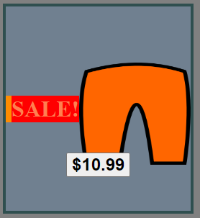
Day 2: Create An Item Container
CSS (styles.css)
#itemContainer{
border: 4px solid darkslategray;
background-color: slategrey;
height: 30%;
width: 20%;
float: left;
display: flex;
margin: 1%;
align-items: center;
justify-content: center;
}
#itemContainer:hover{ background-color: gold;}
#itemImage {
width: 80%;
height: 50%;
padding-top: 5%;
margin-left: auto;
margin-right: auto;
}
#sale {
border-left: 8px solid darkorange;
color: coral;
float: right;
font-weight: bold;
font-size: xx-large;
background-color: red;
cursor: default;
}
HTML
<link rel="stylesheet" href="assets/styles.css">
<div id=“itemContainer”>
<div id=“sale”>
SALE!
</div>
<img id=“itemImage” src=“assets/orange-pants.png”>
<button>
<b>
$10.99
</b>
</button>
</div>

Slide 6
Day 3: Create The “All Items” Display
Combine New, Sale, and Regular Items in an organized manner

Slide 7
Day 4: Create the Header
A tab for each page that navigates to that page upon clicking

Slide 8
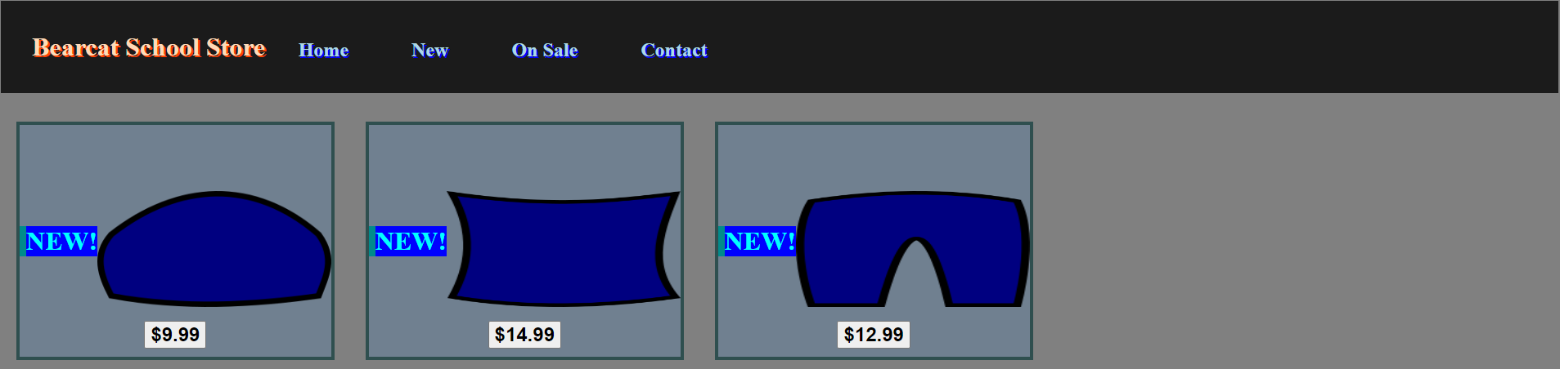
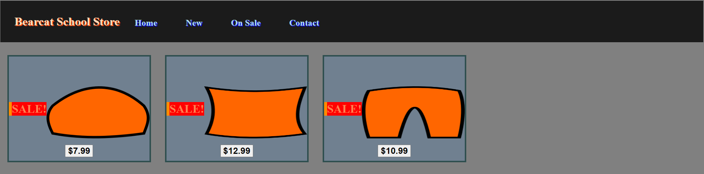
Day 5: Create the “New” and “Sale” Pages

Slide 9

Day 6: Create The Contact Form

Slide 10
Day 7: Catchup + Go The Extra Mile!
Add a product page that contains information for each product that is linked to the image of the product on the products page(s)
Create an item container for out-of-stock items
Create a form for users to create accounts and log in
Create a form for store owners to add new products
Review code to ensure it is easy to read and well-organized

